Slide 1
Wireless Access technology landscapes

Slide 2
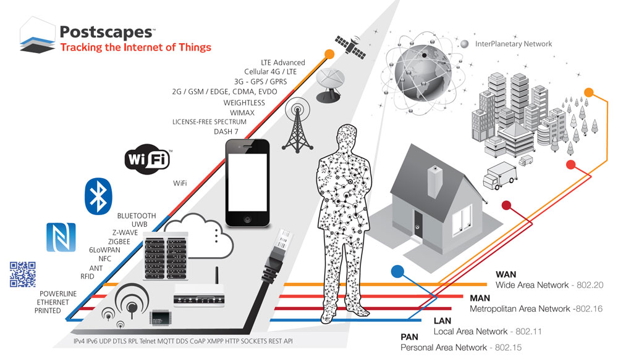
Existing wireless technology
Notes:
There are many factors to consider for Internet of Things (IoT)
applications, including node cost, network cost, battery lifetime,
data rate (throughput), latency, mobility, range, coverage, and
deployment model. No single technology will be able to solve
all factors simultaneously

Slide 3
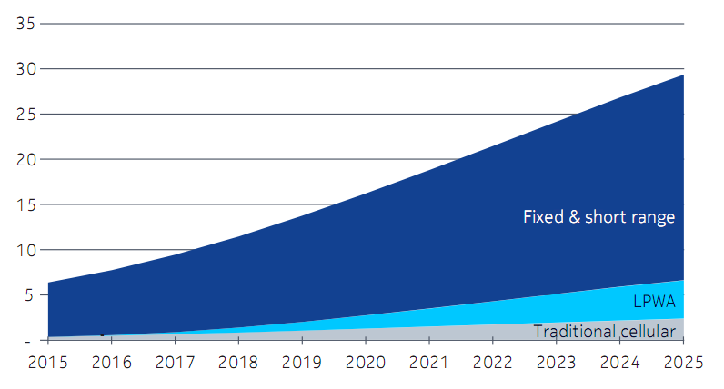
Existing wireless technology
Notes:
There are many factors to consider for Internet of Things (IoT)
applications, including node cost, network cost, battery lifetime,
data rate (throughput), latency, mobility, range, coverage, and
deployment model. No single technology will be able to solve
all factors simultaneously
The total M2M market is estimated to be 30 billion connected devices by 2025 [Machina Research, May 2015].
Fixed and short-range communication will be used for most connections. However, there is also a
significant number (around seven billion by 2025) of connections expected via traditional cellular IoT and
LPWA networks (Figure 1).

Slide 4
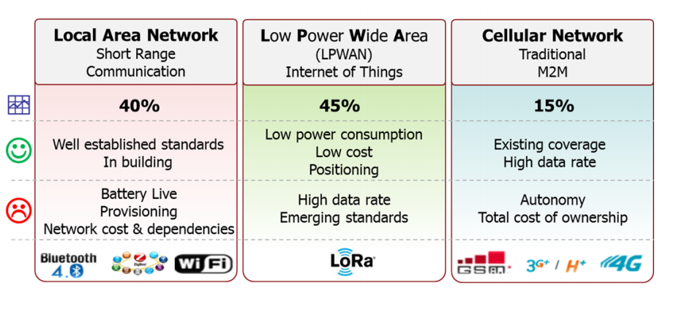
Existing wireless technology
Notes:
We see here, the LAN including
Wifi, Bluetooth, Zigbee, and Z-wave are well suited for short range, have well establish standard and perform very well in enterprise and building, but the disadvantages is in
provisioning, network cost,…
While Cellular Network is a great fit for applications that need high data throughput and have a power source.
And, finally LPWAN as its name, offers lowpower consumption, lost cost deployment, the trade off is low data rate, and emerging standard offers multi-years battery lifetimes and is designed for sensors and applications that need to send small amount of data over long distance a few times per hour from varying environment
. But all the three kind above technologies will have some modification, improvement to fit future use cases, that we will talk later.

Slide 5


LPWAN
Low Power Wide Area Network
Long Range : Lora advertise up to 13.6 miles
Low deployment cost
Battery – Conscious : Sigfox advertise 10 years on 1 AA battery
Narrow band: Reduce interference, low data rate
Unlicensed band: No cost, hit the market early, no QoS
Proprietary: Lack of standardization
Notes:
This seems contradictory, but remember-- energy drains your battery, power gives you range. Both are related where energy equates to power multiplied by time. To achieve low energy at a high power, one only needs to design a system which would be able to achieve data transfer in a short time while sleeping in an ultra-low power state with the remainder of the time. With a larger range due to a high power gain, the amount of repeaters and gateways can be drastically diminished, and reliability improved Beyond cellular evolutions, the new wireless IoT connectivity family named ‘LPWA’ networks is well suited to
support services and use cases which need long range communication (dozens of km) to reach devices which
must have a low power consumption budget in order to operate several years remotely on a single battery pack.
The ideal behind LPWA is that we design a system which would be able to achieve data transfer in a short time while sleeping in an ultra-low power state with the remainder of the time. With a larger range due to a high power gain, the amount of repeaters and gateways can be drastically diminished, and reliability improved
The trade-off is a low data rate delivered by LPWA network technologies, from 300 bps up to 5 kbps (with 125 kHz
bandwith) in LoRa modulation.
Battery – Coinscious: devices will only send a few messages per day, only useful for non delay sensitive and most of the time in hibernate state, therefore those technology will optimized the resynchnoriztion process when device is activated from hibernate state to increase the battery lifetime
All the LPWA technology operated in unlicensed spectrum.
The advantages of using unlicensed spectrum so that those technology hit the market early, then earlier stimulate the ecosystem.
There are also clear downsides of using unlicensed spectrum for long-range
communication. Because there are many typical regulation imposes several restrictions
on radio transmitters in unlicensed spectrum [9] in terms
of effective radiated power (ERP), allowed duty cycles, and
listen-before-talk requirements. For long-range transmissions,
the limited ERP causes asymmetric link budgets between
uplink and downlink directions
Further, scalability limitations come from the range covered by a single
LPWA base station [7]. Projecting that the total number of
connected M2M devices is to become approximately 10 times
larger than the number of people, easily millions of devices
may appear within the coverage area of a single LPWA base
station. Many of those will use other radio technologies that
share the spectrum with LPWA, such as low-power WiFi
(IEEE 802.11ah), Z-Wave, Zigbee, IEEE 802.15.4g, etc. With
its low receiver sensitivity for long-range communication, the
LPWA device will perceive all of these other transmissions as
interference. Despite the fact, they are using some modification to reduce interference, but we cannot avoid this
We therefore foresee that LPWA will only remain viable
at the early stage of IoT development when the number
of devices is still moderate. However, LPWA can play an
important role to support the early IoT market up-take until
standardized cellular M2M solutions enter the market, which
can handle the anticipated IoT scale in terms of numbers
of devices, but also the variety of M2M services
AS I talk before, all the LPWA is proprietary so there is a lack of standardization

Slide 6
Sigfox vs Lora
Properties | Sigfox | LoraWan
Spectrum | 868/902 MHz Unlicensed band | 433/868/780/915 < 1GHz Unlicensed band
Bandwidth | 200 Hz | < 500 kHz
Data Rate | UL : < 300 bps DL: 8 bits per day | < 50kbps (UL/DL)
Packet size | 12 bits | User defined
Range | Rural: 30 – 50km Urban 3 – 10km | Rural : 15km Urban: 2- 5km
Business Model | Proprietary | More open
Notes:
We will see some important technical parameter of two dominated LPWA technology: Sigfox and Lora. Based on those parameters we can derive the appropriate use cases of those technology.
The very important difference between Lora and sigfox is in business model.
SigFox gives away the hardware enablers but sells the software/network as a service, in that all traffic through a Sigfox deployment must be routed through the Sigfox cloud platform, which requires users to sign with Sigfox and continuing paying the firm to keep up the deployment. LoRa is an open alliance in the sense that any organization can purchase LoRa hardware and deploy its own networks without going through (and having to pay fees to) any centralized authority.
,.
The unlicensed spectrum is specified for each region, low spectrum for better communication range.
LoRa sits above Sigfox in terms of throughput and is ideal for data transfer. Another important consideration is that LoRa offers effective bidirectional functionality – so it is good for receiving messages from endpoints, but also for sending messages from base stations to endpoints (like for command and control applications).
Use Cases For LoRa & SigFox
LoRa is likely the better option if you need true bidirectionality .. So if you need command-and-control functionality—for, say, electric grid monitoring—LoRa is your best option.
With SigFox, it is better for applications that send only small and infrequent bursts of data (like alarms and meters).

Slide 7
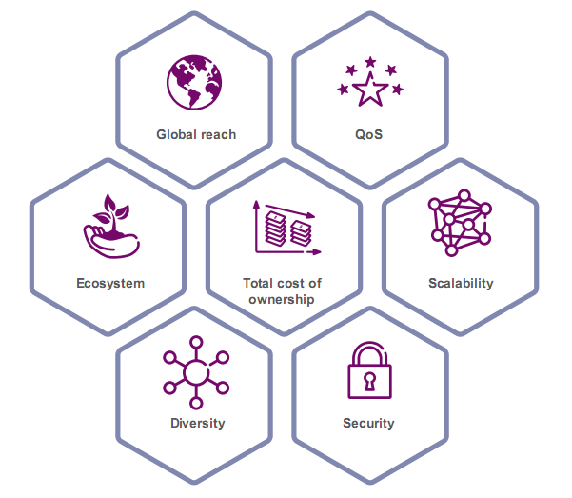
Cellular for IoT
LTE– M : Cat 0, Cat 1, Cat M
EC – GSM
NB - IoT
Notes:
Cellular is an Wide Area Network, but it Is known that consume large energy of device, hence currently, cellular is enhanced to suitable with IoT devices
Require lower power consumption, we can consider cellular is LPWA but operate in licensed spectrum.
Why they have to enhance cellular for iot, because it posses many advantage.
cellular networks already cover 90 percent of the world’s population.
WCDMA and LTE are catching up, but GSM will offer superior coverage in many markets for
years to come.
Te cellular mobile industry represents a huge and mature ecosystem, incorporating chipset,
device and network equipment vendors, operators, application providers and many others. The
global cellular ecosystem is governed by the 3GPP standardization forum, which guarantees
broad industry support for future development.
When it comes to scalability, cellular networks are built to handle massive volumes of mobile
broadband traffic; the traffic from most IoT applications will be relatively small and easily absorbed.
Operation in licensed spectrum also provides Quality of service for communication.
Cellular connectivity offers the diversity to serve a wide range of applications with varying
requirements within one network. While competing unlicensed LPWA technologies are designed
solely for very low-end MTC applications, cellular networks can address everything from Massive
to Critical IoT use cases.
Talk about, the security mechanisms of cellular networks, it have been based on a physical SIM
attached to the device, referred to as a Universal Integrated Circuit Card (UICC). This has also
enabled roaming between operators, which has been one of the main factors behind the huge
success of mobile networks. The SIM will also be essential in future IoT applications, with SIM
functionality embedded in the chipset (eUICC) or handled as a soft-SIM solution running in a
trusted run-time environment of the module. No single technology or solution is ideally suited to all the different potential Massive IoT
applications, market situations and spectrum availability. As a result, the mobile industry is
standardizing several LPWA technologies, including Extended Coverage GSM (EC-GSM), LTE-M
and NB-IoT.
We talk about the enhancement, so what is it.
Lower device cost – cutting module cost for LTE devices by reducing peak rate, memory
requirement and device complexity. The LTE module cost-reduction evolution started in Release
8 with the introduction of LTE for machine-type communication (LTE-M) Cat 1 devices with
reduced peak rate to a maximum of 10Mbps, and continued in Releases 12 and 13 with
reduced device complexity for lower performance and using less bandwidth or a narrowband
IoT carrier to cut costs further.
Improved battery life – more than 10 years of battery life can be achieved by introducing Power
Saving Mode and/or extended discontinuous reception (eDRX) functionality. These features
allow the device to contact the network – or to be contacted – on a per-need basis, meaning
that it can stay in sleep mode for minutes, hours or even days.
Improved coverage – an improvement of 15dB on LTE-M and of 20dB on NB-IoT and GSM,
which translates into a seven-fold increase in the outdoor coverage area and significantly
improved indoor signal penetration to reach deep indoors. This supports many IoT devices
like smart meters, which are often placed in a basement.

Slide 8
Lte-M, Ec-GSM, NB – IOT
All have battery-life : 10 years
Properties | Lora | EC – GSM | LTE - M |  |  | NB - IoT
 |  |  | Cat 1 | Cat 0 | Cat M
Coverage | <16km 155dB | <35km 164dB | <100km 144dB | <100km 144dB | <100km 156dB | <35km 164dB
Spectrum | Unlicensed <1 GHz | Licensed GSM band | Licensed LTE in - band |  |  | Licensed LTE In-band Guard-band Stand-alone
Bandwidth | <500kHz | 200kHz | 20MHz | 1.4MHz | 1.08MHz | 180kHz
Data rate | <50kbps (UL/DL) | <140kbps (UL/DL) | <10Mbps(Dl) <5Mbps(UL) | <1Mbps (UL/DL) | <1Mbps (UL/DL) | <170kbps(DL) <250kbps(UL)
Notes:
Here is a table to compare the parameter of LTE-M, NB-IoT and EC-GSM with an LPWA operaed in unlicensed band Lora LTE-M, NB-IoT and EC-GSM are all superior solutions to meet Massive IoT requirements as
a family of solutions, and can complement each other based on technology availability, use case
requirements and deployment scenarios. LTE-M consisting of Cat 1, Cat 0 and Cat M supports
a wide range of IoT applications, including those that are content-rich; NB-IoT covers ultra-low-
end IoT applications with a cost and coverage advantage over LTE-M; and EC-GSM serves IoT
services for all GSM markets.
For example, a smart city application such as waste management may use EC-GSM technology
to provide LPWA connectivity in markets where it can be deployed on existing 2G networks;
NB-IoT technology may be used for water-metering applications, which have some of the most
extreme coverage requirements in underground locations. On the other hand, asset-tracking
applications that can support a relatively high number of messages triggered by certain events
may employ LTE-M.

Slide 9
NB-IOT - SUPPORTING ULTRA-LOW-END MASSIVE IOT APPLICATIONS
Achieve up to 10 years’ battery life: power save mode, eDRX
Coverage over long distances and deep penetration
Run adjacent to existing cellular networks: with 3 modules
In band, guard-band, stand-alone
Low devices cost
Application: Smart metering, alarms for homes & commercial properties, Asset tracking, Smart City as street lamps, Industrial Appliances
Notes:
Narrowband-IoT, or NB-IoT, is designed to more
closely match the requirements of LPWA-type networks, NB-IoT is the foundation for Narrowband 5G.
NB-IoT promises to achieve up to 10 years’ battery life on a single charge. It incorporates technologies that enable devices to power down when data is not being transmitted, as well as enhanced discontinuous reception (eDRX) to conserve battery life.
NB-IoT is optimised for low throughput, whether over long or short distances, and has optimised data transfer to support small, intermittent blocks of data. Uplink and downlink rates of around 200kbps are supported.
Power spectrum density (PSD) boosting and repetition in NB-IoT can deliver coverage gains of 20dB when compared with GSM networks, enabling about ten times better area coverage.
NB-IoT supports 3 modes
of operation in terms of frequency; standalone, guard band, and in-band. The guard band
mode, as the name suggests, utilizes the otherwise unused narrow resource block within
an LTE carrier’s guard band. The in-band mode utilizes resource blocks within a normal LTE
carrier. The standalone mode operates in its own individual block of frequency and may be
deployed either on an LTE band or as part of a formerly used GSM carrier.
The unit cost of NB-IoT devices is expected to be low and to fall as demand picks up, with the 3GPP believing this can get to below $5 per module s, it’s ideal to have about 50K devices per cell; this is possible assuming there are
the household density per every sq m is 1500 with 40 devices in every household.
Smart metering (electricity, gas and water)
• Facility management services
• Intruder alarms & fire alarms for homes & commercial properties
• Connected personal appliances measuring health parameters
• Tracking of persons, animals or objects
Smart Home • Smart city infrastructure such as street lamps or dustbins
• Connected industrial appliances such as welding machines or air compressors.

Slide 10
LTE-M – SUPPORTING A WIDE RANGE OF MASSIVE IOT USE CASES
Achieve up to 10 years’ battery life : Power save mode, eDRX
Coverage over long distances
Wide range of bit-rates: Enabling advanced applications
Reduced devices cost
Support for a massive number of device
Application: Smart metering, alarms for homes & commercial properties, Asset tracking, Smart City as street lamps, Industrial Appliances
Notes:
Similar to NB- IOT, but with diferent parameters as coverage, data rate.
The advent of LTE-M signifies an important step in addressing MTC capabilities over LTE.
LTE-M brings new power-saving functionality suitable for serving a variety of IoT applications;
Power Saving Mode and eDRX extend battery life for LTE-M to 10 years or more. LTE-M traffic
is multiplexed over a full LTE carrier, and it is therefore able to tap into the full capacity of LTE.
Additionally, new functionality for substantially reduced device cost and extended coverage for
LTE-M are also specified within 3GPP
Broadest range of
cellular IoT capabilities
Wide range of bit-rates
enabling advanced
applications
Efficient co-existence
with MBB traffic

Slide 11
EC-GSM – GLOBAL CELLULAR IOT FOR ALL GSM MARKETS
Achieve up to 10 years’ battery life : Power save mode, eDRX
Coverage improvements : up to 20dB with respect to GPRS
Multiplexing with EDGE and GPRS:
Reduced devices cost
Support for a massive number of device : 50000
Application: Smart metering, sensor monitoring in agriculture..
Notes:
. GSM is likely to continue playing a key role in the IoT well into the future, due to its global coverage footprint, time to market and
cost advantages.
Recognizing this – and identifying the requirements for Massive IoT discussed earlier in this
paper – an initiative was undertaken in 3GPP Release 13 to further improve GSM.
EC-GSM functionality enables coverage improvements of up to 20dB with respect
to GPRS on the 900MHz band.
This coverage extension is achieved for both the data and control planes by utilizing the concept
of repetitions and signal combining techniques. It is handled in a dynamic manner with multiple
coverage classes to ensure optimal balance between coverage and performance.
EC-GSM is achieved by defining new control and data channels mapped over legacy GSM. It
allows multiplexing of new EC-GSM devices and traffic with legacy EDGE and GPRS. No new
network carriers are required: new software on existing GSM networks is sufficient and provides
combined capacity of up to 50,000 devices per cell on a single transceiver
r.

Slide 12
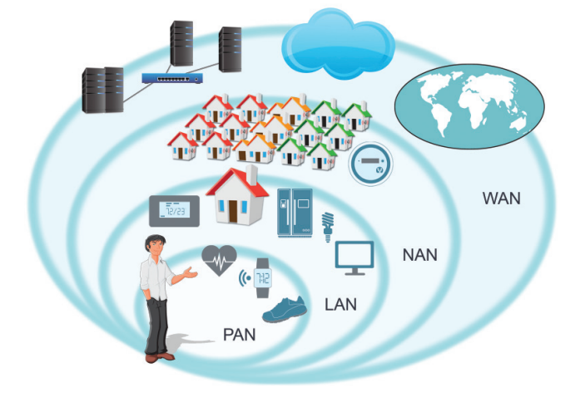
Short range technology
Properties | WLAN | BLE | Zigbee | Z-Wave
Frequency band | 2.4 GHz Unlicensed band | 2.4 GHz Unlicensed band | 2.4 GHz Unlicensed band | 908/916MHz Unlicensed band
Data Rate | Very high | 20 kbps | 20 - 250 kbps | 9.6 – 100kbps
Battery Life (days) | 1 | 100 -1000 | 100 -1000
Network Size (devices) | Dozens | 10 - 20 | 65+k | 232
Range | 32 – 100 meters | 5 meters | 100+ meters | 100meters
Notes:
Talk about Short range technology, PANs are usually wireless and cover a range of about 10 meters. A common wireless PAN is a smartphone
connected over Bluetooth® to handful of accessories such as wireless headset, watch or ﬁ tness device. Wire-
less PAN devices usually have low radio transmission power and run over small batteries.
LANs are either wired or wireless (or a combination of the two). Wireless LANs (WLANs) usually cover a
range up to 100 meters. A predominant example is a home Wi-Fi network providing Internet access to per-
sonal computers, smartphones, TVs and today even to IoT devices such as thermostats and home appliance.
except Zwave all the technology use 2.4 Ghz unlicensed band.
because it is allowed for unlicensed use in all regions. The ubiquity of the 2.4 GHz band makes development and distribution of 2.4 GHz-based
products across nations easier.
Although in same group but the characteristic of each technology is quite different.
Wifi, Bluetooth is follow star topology, and zwave and zigbee follow mesh topology, this reason create the main differences between them.
Mesh networks like Zigbee and Z-Wave don’t experience this kind of signal loss — partly because they are very low-bandwidth to begin with. And that low-bandwidth makes these two standards great for simple devices like window and door motion sensors, or smart lightbulbs that only need data connections to turn on or off. One problem with Zigbee and Z-Wave, however, is that their signals aren’t directly compatible with any mainstream computing device, like a smartphone, tablet, or laptop. So, the bulbs and motion sensors need to communicate with a hub that is either connected to your home network via Wi-Fi or through an ethernet cable plugged into to your Internet router
ZigBee can deliver up to 250KBps of data throughput, but is typically used at much
lower data rates. Zigbee network could have 65k devices, but usually use for home appliance, not applicable for large system as smart city,
Smart industry ( using unlicensed band, mesh network (complexity ), maintainance cost)

Slide 13
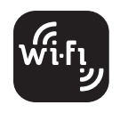
Wifi
Near ubiquitous network coverage in enterprises
High bandwidth capabilities
Limited range : Using many AP for large area
High energy consumption
Provisioning of credentials is difficult
Application: Smart home thermostats/power meters
Notes:
Wi-Fi have Near ubiquitous network coverage in enterprises
Limited Ranged : Wi-Fi networks have a star topology, with the AP being the Internet gateway. The output power of Wi-Fi is
high enough to allow full in-home coverage in most cases. But In enterprise and in large buildings, more than
one AP is often deployed in different locations inside the building to increase the network coverage.
High energy consumption
To enable high data rates (over 100MBps in some cases) and good indoor coverage, Wi-Fi radios have
fairly large power consumption. For some IoT devices, which run on batteries and cannot be charged
frequently, Wi-Fi can be too power hungry. Although new silicon devices apply advanced sleep protocols and fast on/off time to reduce the average power
consumption dramatically. Since most IoT products do not need the maximum data rates Wi-Fi offers, clever
power management design can
keep products connected to the Internet for over a year using two AA alkaline batteries.
It is difficult to provision credential into wifi access point.
This does, however, come with one key drawback: interference and bandwidth issues. If your house is full of Wi-Fi-connected gadgets (TVs, game consoles, laptops, tablets, etc.) then your smart devices will have to compete for bandwidth and may be slower to response. ( Low power wifi)
Smart home thermostats/power meters
In the future, the will have the appearance of low power wifi specifically for IoT applications.

Slide 14

Bluetooth Low Energy
PAN technology: smartphone, tablet act as gateway
Low energy consumption: Yeas battery-life
Include application profile : Interoperability
Limited range : 5 meters
Application: Wearables, light control, proximity monitors, asset trackers
Notes:
Bluetooth is a PAN technology primarily used today as a cable replacement for short-
range communication.
Ble is Designed to significantly reduces the power con-
sumption of Bluetooth devices and enables years of operation using coin cell batteries. Supported by the new
generation of smartphones and tablets, Bluetooth low energy enabled a wide range of new applications spanning health and ﬁ tness, toys, automotive and industrial
spaces.
The Bluetooth low energy standard can theoretically support an unlimited
number of devices, but the practical number of simultaneously connected devices is between 10 and 20.
One of the advantages of the Bluetooth standard is that it includes application proﬁ les. These proﬁ les
deﬁ ne in great detail how applications exchange information to achieve speciﬁ c tasks., help-
ing Bluetooth achieve excellent interoperability in the market.
The application of BLE is Wearables, light control, proximity monitors, asset trackers
It has been reported that the newest version of Bluetooth (Bluetooth Low Energy, or BLE) will be capable of forming mesh networks, greatly extending its range to compete with Zwave and Zigbee

Slide 15

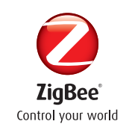
Zigbee/Z-wave
Mesh network : Large number of devices, higher range
Low energy consumption : Years battery-life
Low cost technology
Unlicensed band
Application: Sense and control networks as home automation
Notes:
Because two technology is quite similar so we will discuss both in same slice
ZigBee and Zwave technology follow mesh topology, where data hops from node to node in multiple directions and
paths throughout large scale networks, to control large number of device and higher range of communication
It both offer low energy consumption
ZigBee can be used in multiple applications, but it has gained the
largest momentum and success in smart energy, home automation and in lighting control applications, each
of which has a speciﬁ c ZigBee proﬁ le and certiﬁ cation
The main difference between Zigbee and Zwave is the inter operablity
ZigBee has been poor by inter-operability problems. The ZigBee standard defines not only the wireless transport mechanism, but also a software layer (similar to Bluetooth) that provides profiles that can have interfered with different versions of other ZigBee profiles. which often have difficulty communicating with those from different manufacturers. As a result, ZigBee is not an ideal choice for anyone just starting down the home automation road—unless, of course, they use device from just one manufacturer. Plus, there are different versions of ZigBee which do not talk seamlessly with each other.
Differently, A significant advantage of Z-Wave is its interoperability. All Z-Wave devices talk to all other Z-Wave devices, regardless of type, version or brand
Z-Wave communicates in a sub-gigahertz frequency range, around 900MHZ, competing with a few cordless phones and consumer devices, but steering clear of Wi-Fi, Bluetooth and other systems that operate in the crowded 2.4GHz band. A significant advantage of Z-Wave is its interoperability. All Z-Wave devices talk to all other Z-Wave devices, regardless of type, version or brand
The ISM bands are license-exempt bands which are only lightly regulated, and thus allow for quick time to market of IoT products. However, the restrictions on transmission power and the inability to offer guaranteed data delivery, along with some legal complications, proved really, really imposing. And one of the biggest costs in large-scale Zigbee deployments are the running costs- - mainly the salary of field engineers troubleshooting the network. A 50 pence Zigbee connection suddenly costs $50.

Slide 16
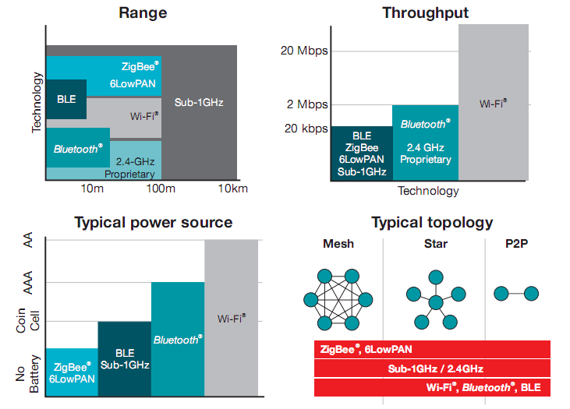
Comparision
Notes:
Above are four figure comparing short range communication technology performance.
A star network architecture provides the best compromise between long range communication, number of
antennas (base stations) and devices battery life.

